Slide 1
Good morning! Welcome to:
Introducing Proof Using Formal Systems
Please:
grab a packet,
take a few moments with the reflection questions,
and then dive into the first WORDs worksheet!
Work by yourself or with a partner, as you see fit.
Let me know if you have any questions.

Slide 2



Introducing Proof
Using Formal Systems
Justin Lanier
Princeton Learning Cooperative
Princeton, NJ
@j_lanier

Slide 3
Use the following rules to change each “word” (each string of letters) into the other.
Next to each step, write down which rule you use.
1) Any letter can change into an A.
2) Two Cs in a row can turn into a B.
3) Any word can be doubled.
(1) (2) (3)
C B C
_____________ _____________ _____________
_____________ _____________ _____________
_____________ _____________ _____________
_____________ _____________ _____________
_____________ _____________ _____________
_____________ _____________ _____________
ACAC ABAB B

Slide 4

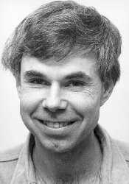

Slide 5
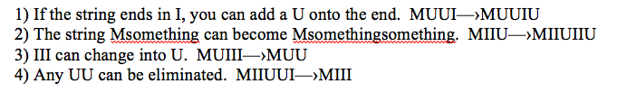
MIU system

Slide 6
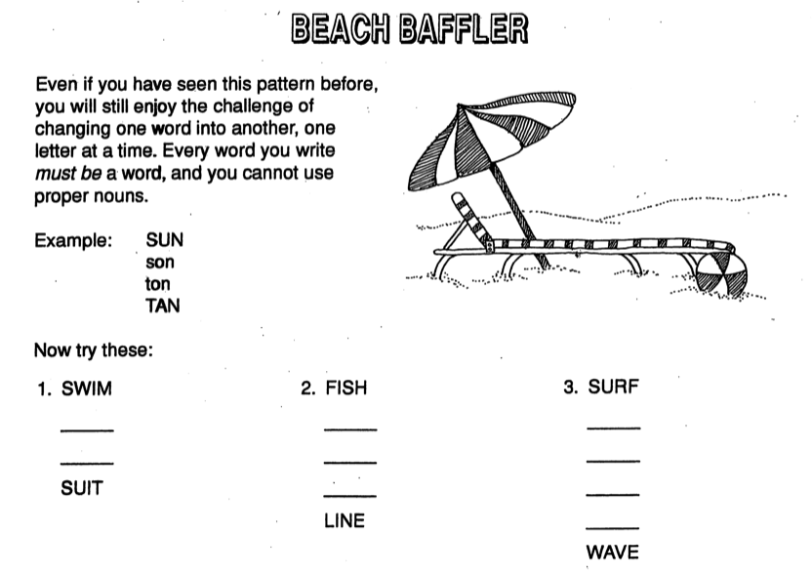

Slide 7
Middle School | High School
Plant seeds about proof Encounter mathematics that doesn’t involve numbers or shapes Try out an activity with a sequential, algebraic “feel” without jumping to algebra Introduce “impossible” problems | Give a concrete picture of proof that’s distinct from geometrical content Highlight the importance and role of axioms in a formal system Introduce transformations, invariants, and even groups

Slide 8
Middle School | High School
Plant seeds about proof Encounter mathematics that doesn’t involve numbers or shapes Try out an activity with a sequential, algebraic “feel” without jumping to algebra Introduce “impossible” problems | Give a concrete picture of proof that’s distinct from geometrical content Highlight the importance and role of axioms in a formal system Introduce transformations, invariants, and even groups
Both
Create mathematics Learn to critique and reflect upon mathematical systems Build mathematical taste Participate in a mathematical community Have a blast!

Slide 9
What is proof for?

Slide 10
What is proof for?
To verify?
To explain?
To convince?
To connect?
To examine assumptions?
To build a system?

Slide 11
What is proof for?
To verify?
To explain?
To convince?
To connect?
To examine assumptions?
To build a system?
Yes!

Slide 12
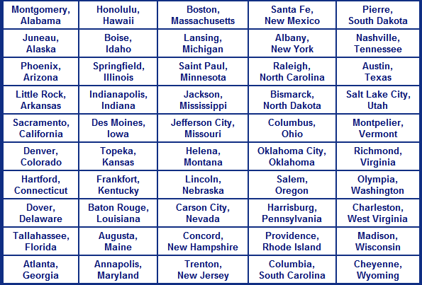

Slide 14
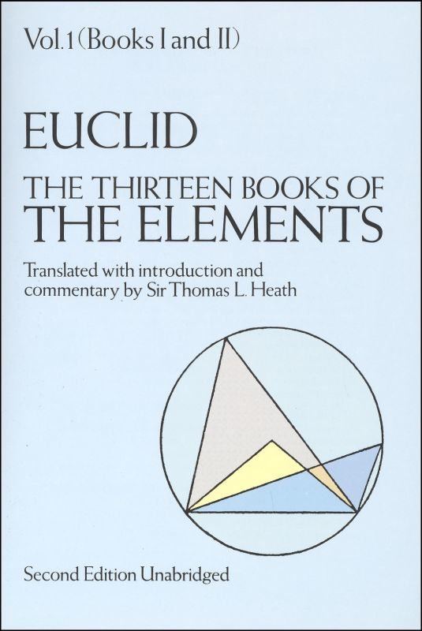
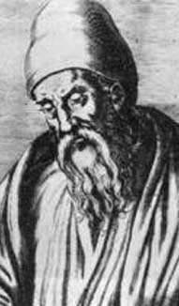

Slide 15
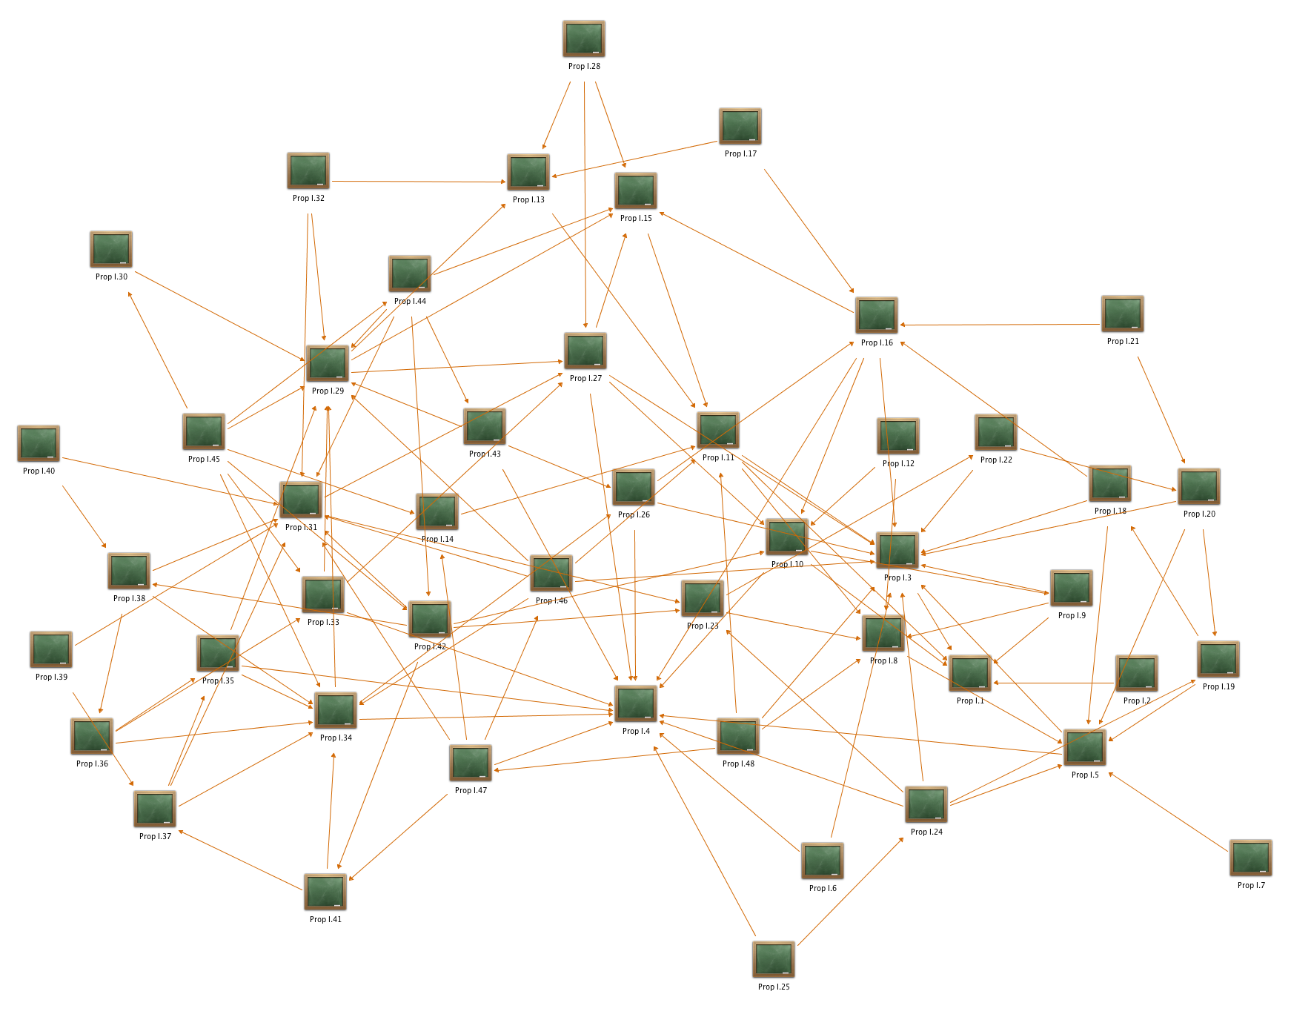

Slide 18
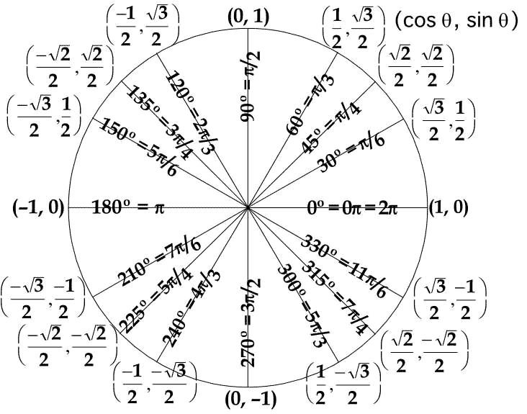

Slide 19
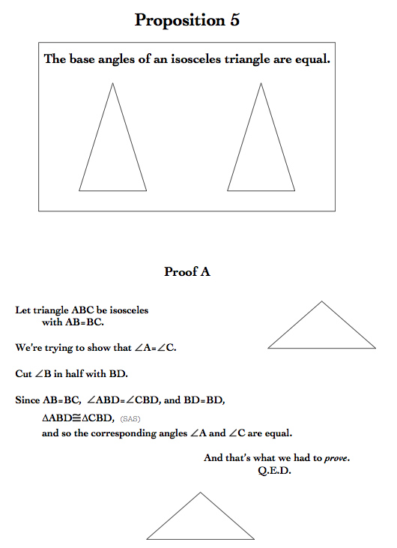
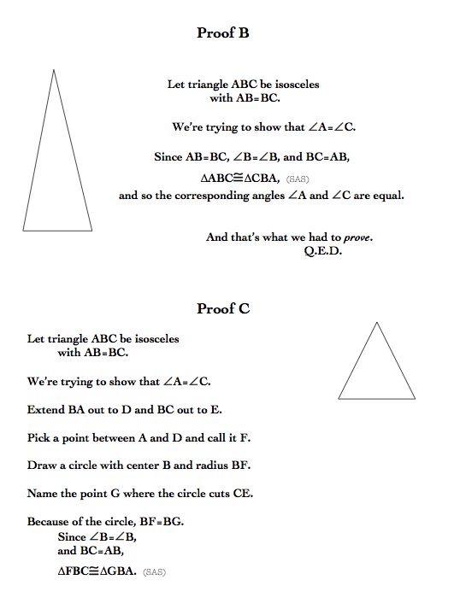

Slide 20
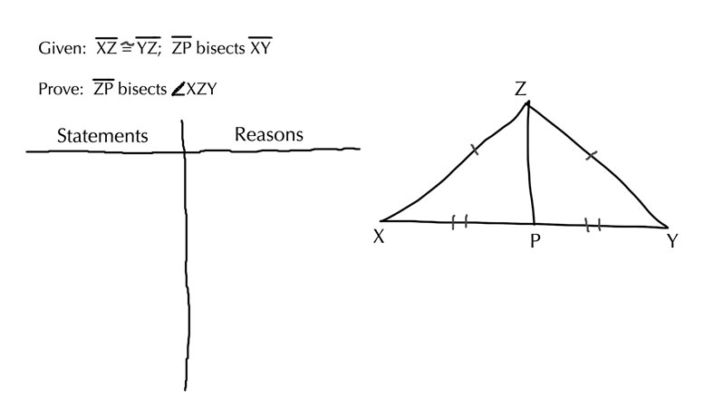
http://www.algebra.com/algebra/homework/Geometry-proofs/Geometry_proofs.faq?hide_answers=1&beginning=90

Slide 21
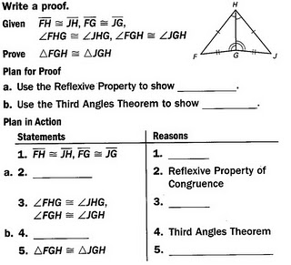
http://mathauthority.blogspot.com/2011/01/geometry-online-question-1.html

Slide 22
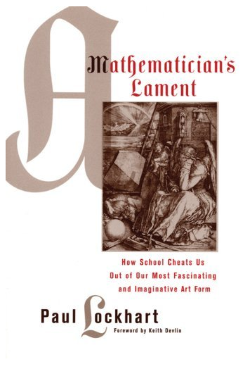
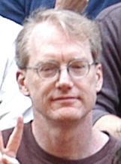

Slide 23
“A proof, that is, a mathematical argument, is a work of fiction, a poem. Its goal is to satisfy. A beautiful proof should explain, and it should explain clearly, deeply, and elegantly…
“There is nothing charming about what passes for proof in geometry class. Students are presented a rigid and dogmatic format in which their so-called “proofs” are to be conducted— a format as unnecessary and inappropriate as insisting that children who wish to plant a garden refer to their flowers by genus and species.”
--from A Mathematician’s Lament

Slide 24
Student arguments about #8
Jordan: I tried and tried and number 8 wasn’t possible (because if you changed the letters it wouldn’t work. Or doubled.)
Lily: I think number 8 is impossible because when you double CAC it becomes CACCAC and you can’t make that combination into 4 letters.
Tucker: 8 is impossible. You can’t double it (CACCAC CABAC CAAAC no)
Can’t change letters (CAA CAACAA no)
It’s not possible.

Slide 25
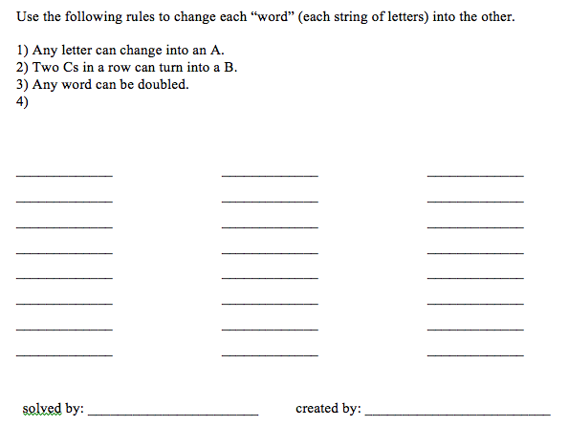

Slide 26
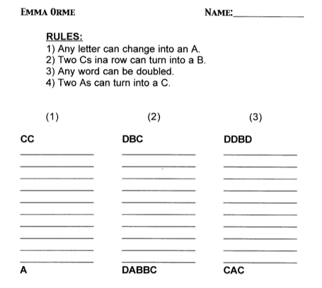

Slide 27
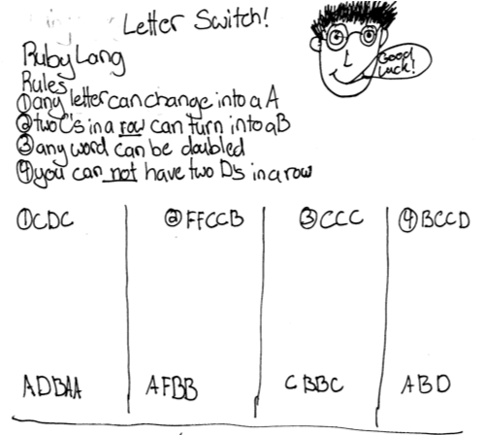

Slide 28
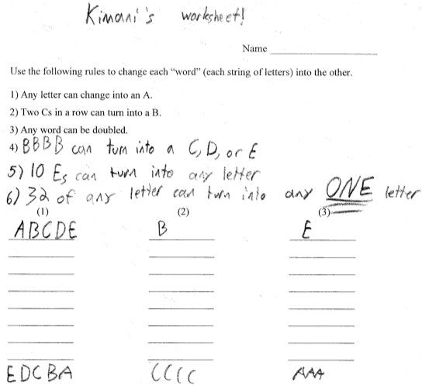

Slide 29
Reflecting and Critiquing
Consider the rules that you and your classmates have added as Rule #4 to the ABC system. Which new rule is…
the most powerful (makes solving problems much easier)?
the least powerful (doesn’t add many new possibilities to the system)?
the most useful (can be used in many circumstances)?
the least useful (hardly ever gets used)?
the trickiest?
the most creative?
the somethingelsest?
Be sure to give reasons for your choices and examples!!!

Slide 30
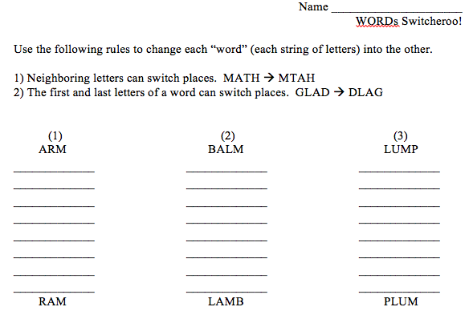

Slide 31
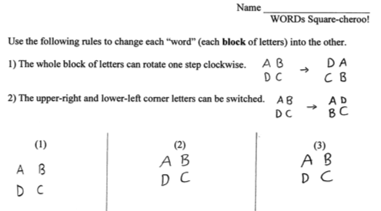
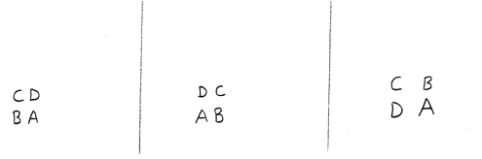

Slide 32
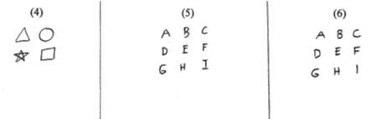


Slide 33
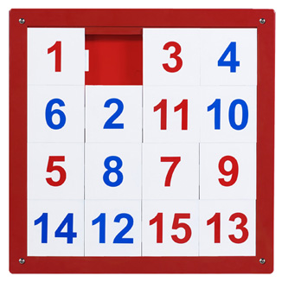


Slide 34
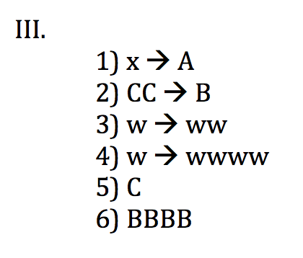

Slide 35
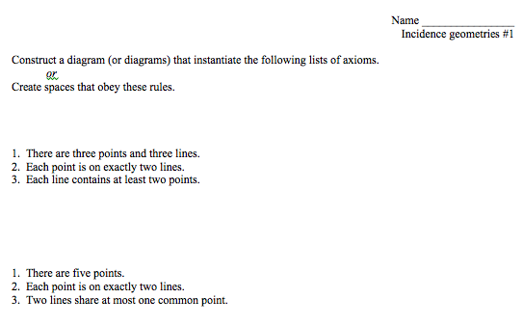

Slide 36
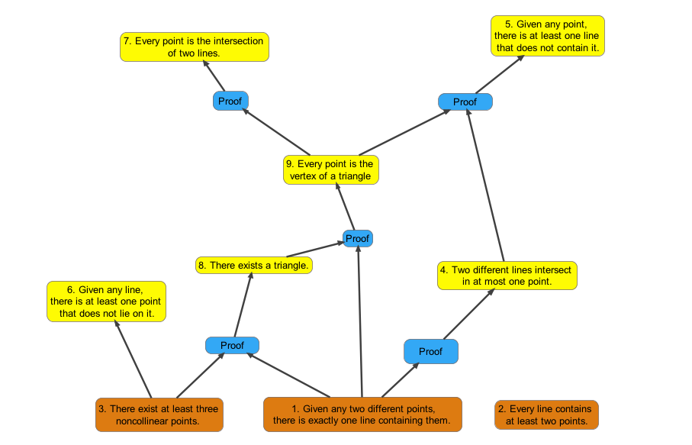

Slide 37
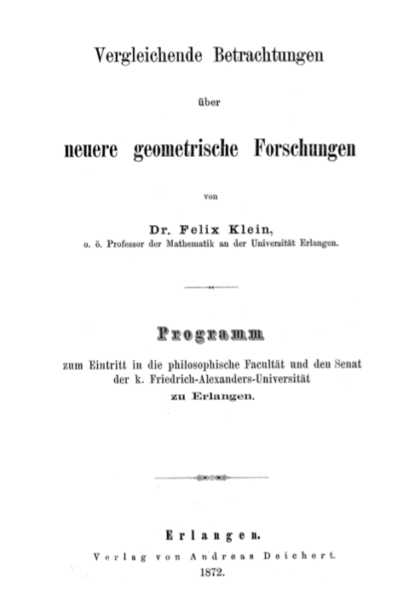
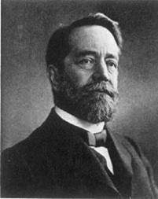

Slide 38
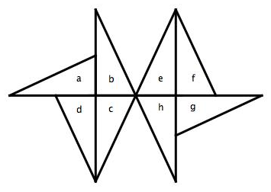
Describe what isometry or combination of isometries
takes the first triangle in each pair to the second.
c to h
b to d
a to b
f to b
g to f
c to a
a to g
e to d
Make up a problem of your own inspired by the one above.

Slide 39
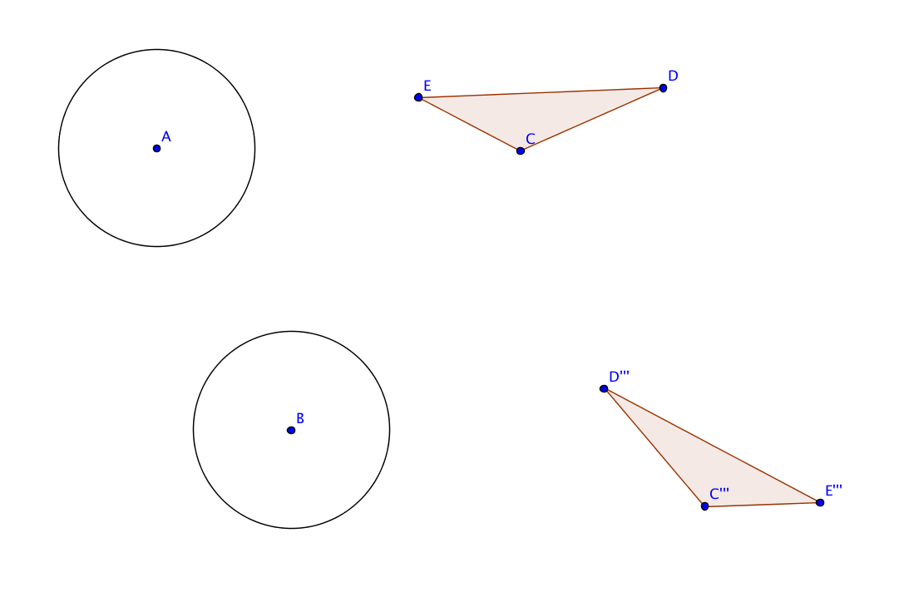
Isometries in the plane

Slide 40
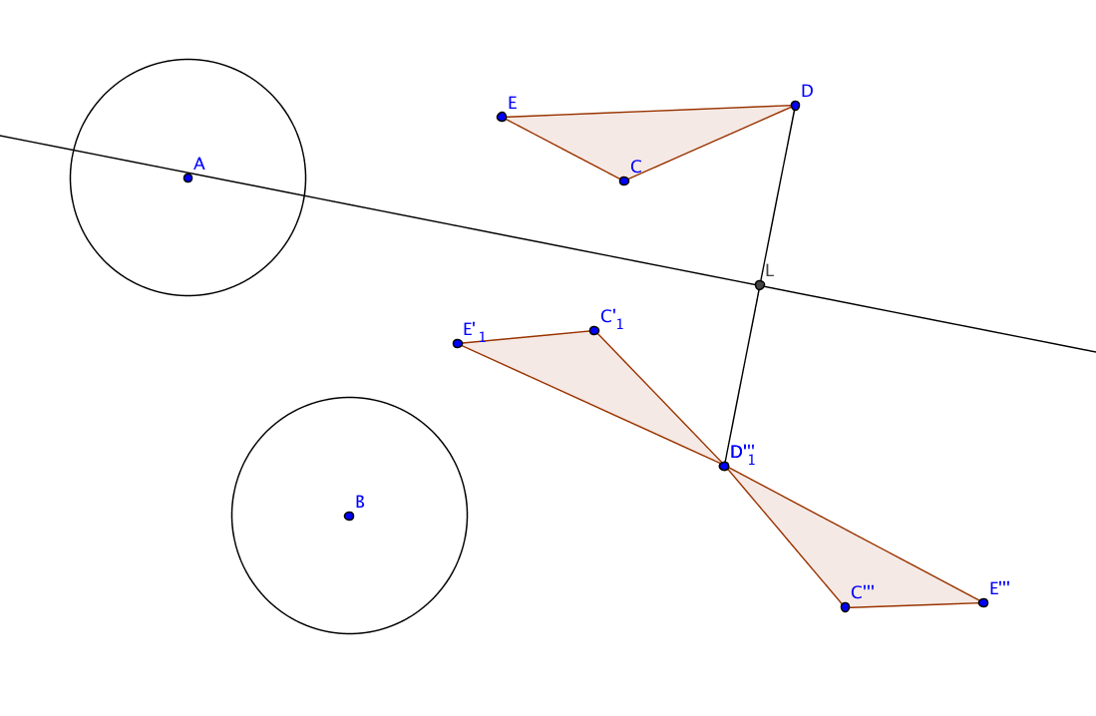
Isometries in the plane

Slide 41
Middle School | High School
Plant seeds about proof Encounter mathematics that doesn’t involve numbers or shapes Try out an activity with a sequential, algebraic “feel” without jumping to algebra Introduce “impossible” problems | Give a concrete picture of proof that’s distinct from geometrical content Highlight the importance and role of axioms in a formal system Introduce transformations, invariants, and even groups
Both
Create mathematics Learn to critique and reflect upon mathematical systems Build mathematical taste Participate in a mathematical community Have a blast!

Slide 42
Thanks for coming!
I’d love to hear from you:
justin.lanier@gmail.com
Feedback! Questions! Anecdotes!

